Slide 1
LIVE DASHBOARD
TEAM MEMBERS
22CDR096-SIVA KAVINDRA T
22CDR107-SWATHINI MK
22CDR119-YESHWANTH M

Slide 2
WORKING
SERVER SIDE
Collect the data from the database connected.
Once the page is opened the data of faculty and the student are collected.
Adding of new department. The request is done from the frontend and the passed data are added to the database.
CLIENT SIDE
Display the data in the form of pie chart.
Request to add the data is sent to the backend along with passing the parameters such as department name, number of faculty , number of students.

Slide 3
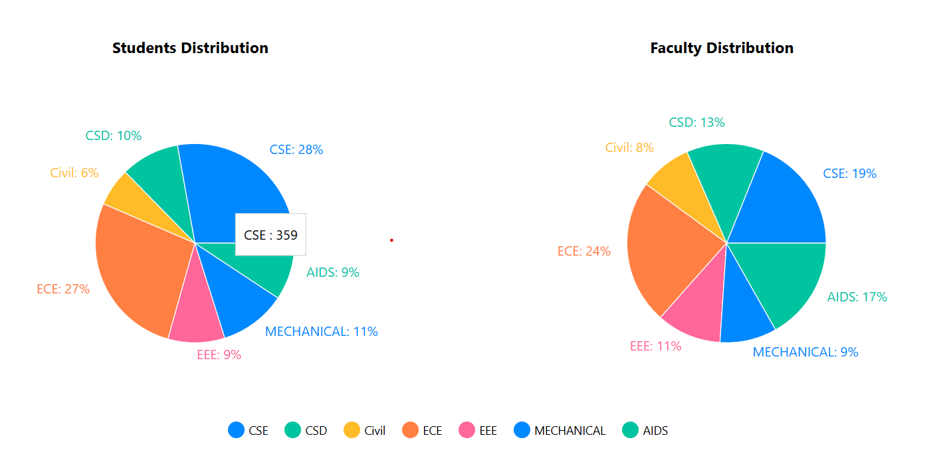

Slide 4
